Slide 1
Measures of Central Tendency

Slide 2

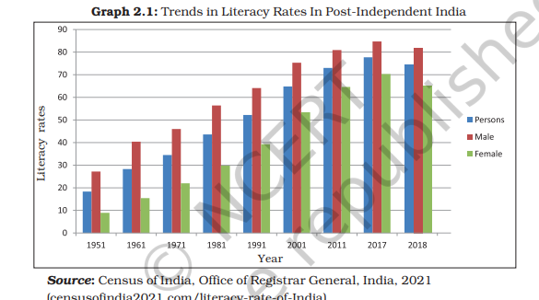
WhY is central tendency
It aims to provide an accurate description of the entire data.

Slide 3
❖ What is central tendency
Measures of Central Tendency
Mode
Median
Mean`
The middle value of a range of values.
The value that occurs most frequently in a given set of data.
dividing the sum of all values in a data set by the number of values.

Slide 4
Mode: The most frequent number—that is, the number that occurs the highest number of times.
Example: The mode of { 2, 4, 9,3, 2, 7} is 2 because it occurs three times, which is more than any other number.

Slide 5
Mean: The "average" number; found by adding all data points and dividing by the number of data points
Example: The mean of 4, 1, and 7 is:-
(4+1+7)/3

Slide 6
Median: The middle number; found by ordering all data points and picking out the one in the middle (or if there are two middle numbers, taking the mean of those two numbers).
Example: The median of 444, 111, and 777 is 444 because when the numbers are put in order (1(1left parenthesis, 1, 444, 7)7)7, right parenthesis, the number 444 is in the middle.

Slide 7



